Slide 1

CSCI 434 Network Traffic Project
Tyler Pringle

Slide 2
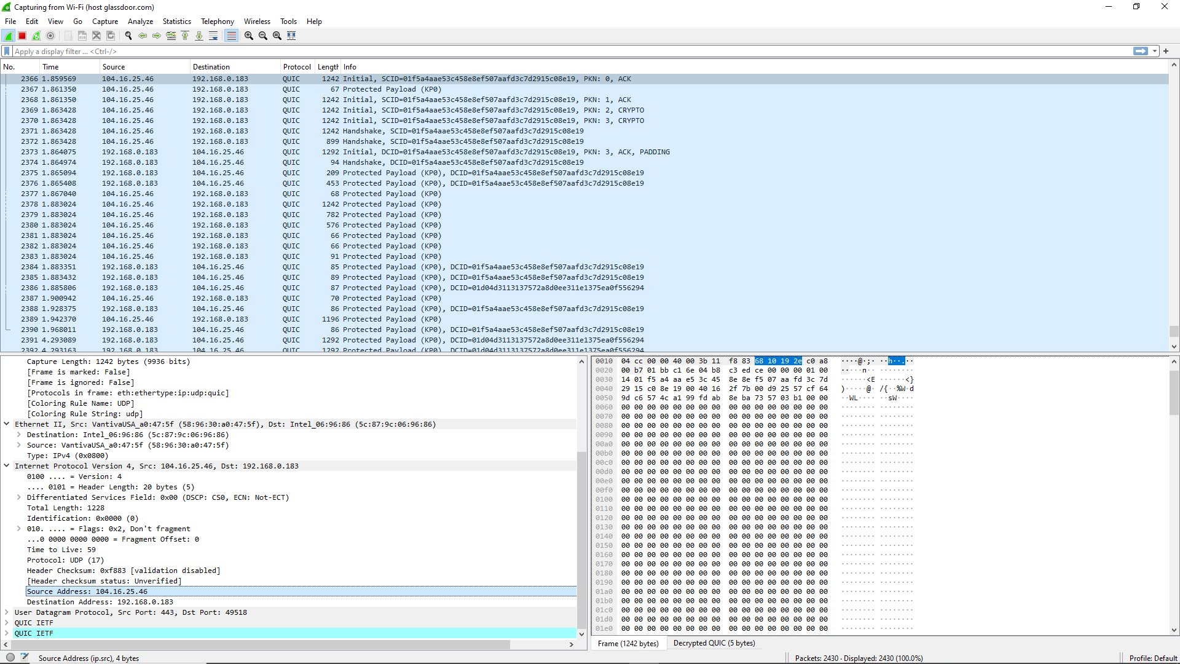





Goals
Monitor network traffic from popular websites
Develop models that extract features from network traffic and automatically classify the origin website of the traffic
Monitor traffic using Wireshark…
…and classify website origin

Slide 3
Dataset
Dataset Size
Label | Size
Glassdoor | 1834
X | 2138
Stack Overflow | 2041
Total | 6013
Dataset Samples
Label | Protocol | Length
Glassdoor | UDP | 1292
Glassdoor | R-GOOSE | 1242
Glassdoor | TLSv1.2 | 227
X | TCP | 66
X | TCP | 54
X | TLSv1.3 | 1414
Stack Overflow | TLSv1.2 | 381
Stack Overflow | TCP | 60
Stack Overflow | TLSv1.2 | 85
… | … | …
Extracted Features
Feature | Details
Protocol | The protocol the packet used for communication. The protocol determines how data is formatted, exchanged, and processed.
Length | The total size, in bytes, of the packet.

Slide 4
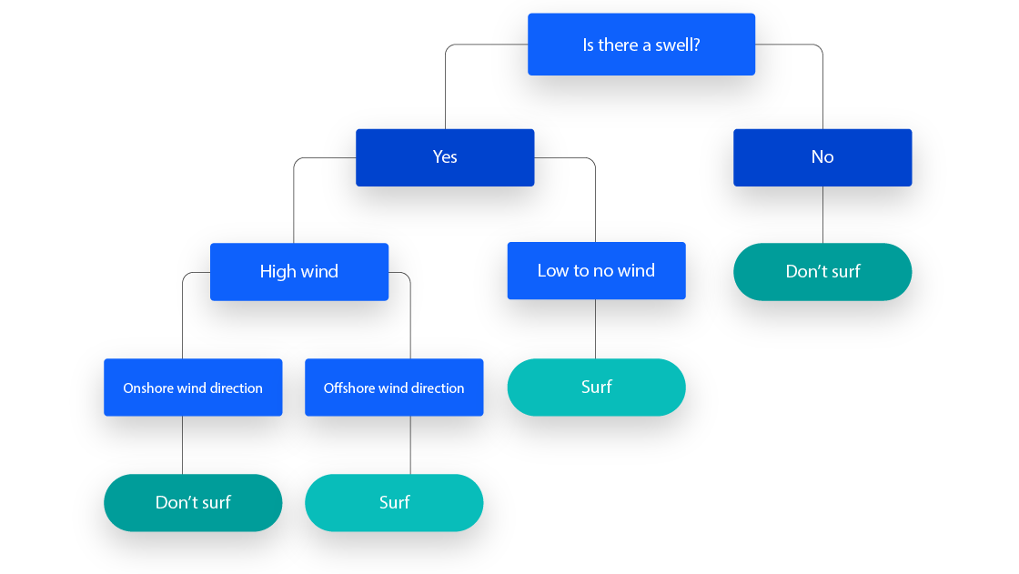
Decision Tree Classifier
A decision tree is a nonparametric supervised learning method for both classification and regression. The tree forms a hierarchical structure with branches where every internal node makes a decision based on the features of the dataset.
A decision tree is made through recursive splitting of the dataset: the tree is created by splitting the dataset into subsets based on the values of the features until a certain stopping criterion is met, like the maximum depth of the tree.
The baseline for the model will be a logistic regression classifier.
Image Source: https://www.ibm.com/topics/decision-trees

Slide 5
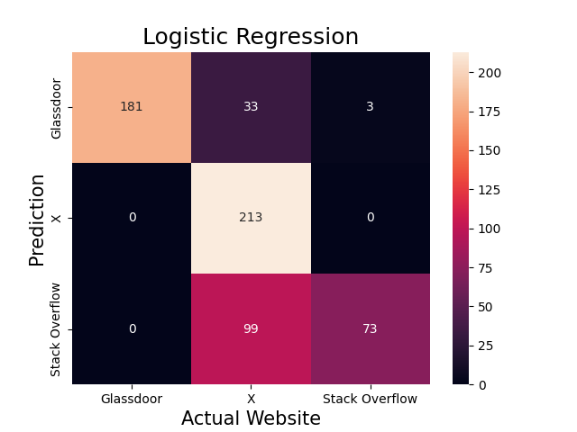
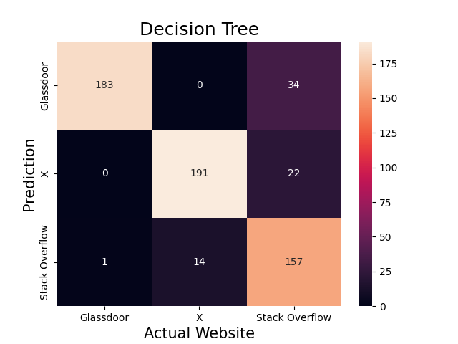
Results
Evaluation Results on testing data
(Train:Validation:Test – 8:1:1)
Model | Accuracy | Macro F1 Score
Logistic Regression | 0.78 | 0.75
Decision Tree | 0.88 | 0.88
The decision tree model outperformed the baseline model in both accuracy and F1 score, by 0.1 and 0.13 respectively.
Based on the confusion matrices to the right, we can see that the decision tree’s predictions tend to align with the actual values. The logistic regression has more trouble, especially with properly identifying traffic from X.

Slide 6
Reflections
The decision tree model sometimes misidentified Stack Overflow traffic as coming from elsewhere, and in rarer cases, identified other traffic as Stack Overflow traffic. Essentially, the issues in the model seem to be related to the Stack Overflow part of the dataset.
My attempts to hypertune the parameters for the decision tree model did not seem to significantly improve the model’s accuracy. More work could be done on that front, though.

